Slide 1
NLP Perceptron lecture 02.1
Branko Žitko

Slide 2
Contents
Basic ideas involved in building neural networks:
activation functions,
loss functions,
optimizers, and
the supervised training setup.

Slide 3
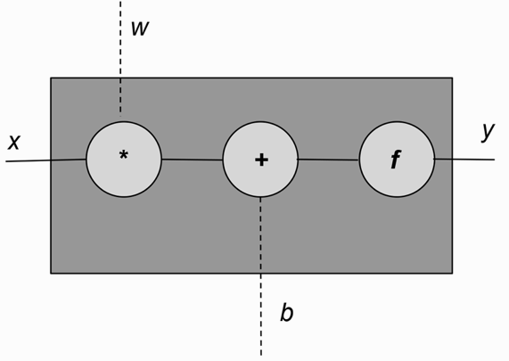
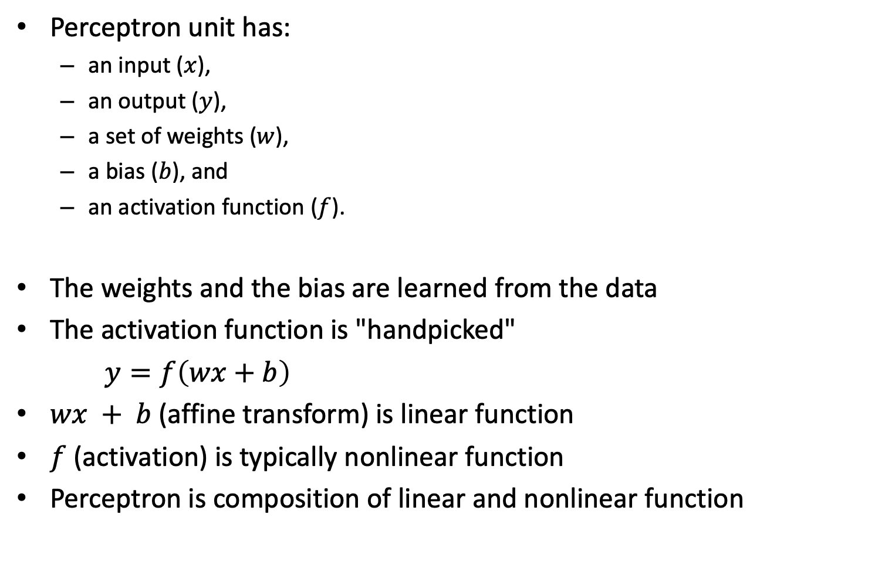
The Perceptron
Perceptron unit has:
an input ($x$),
an output ($y$),
a set of weights ($w$),
a bias ($b$), and
an activation function ($f$).
The weights and the bias are learned from the data
The activation function is "handpicked"
$y=f\left(wx+b\right)$
$wx + b$ (affine transform) is linear function
$f$ (activation) is typically nonlinear function
Perceptron is composition of linear and nonlinear function

Slide 4
The Perceptron
Perceptron
import torch import torch.nn as nn import matplotlib.pyplot as plt class Perceptron(nn.Module): """ A perceptron is one linear layer """ def __init__(self, input_dim): """ Args: input_dim (int): size of the input features """ super(Perceptron, self).__init__() self.fc1 = nn.Linear(input_dim, 1) def forward(self, x_in): """The forward pass of the perceptron Args: x_in (torch.Tensor): an input data tensor x_in.shape should be (batch, num_features) Returns: the resulting tensor. tensor.shape should be (batch,). """ return torch.sigmoid(self.fc1(x_in)).squeeze()

Slide 5
Activation functions
Activation functions are nonlinearities introduced in a neural network to capture complex relationships in data
sigmoid
tanh
ReLU
PreLU
softmax

Slide 6
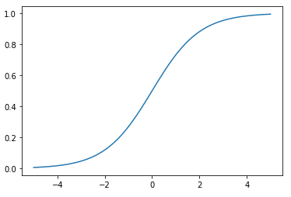
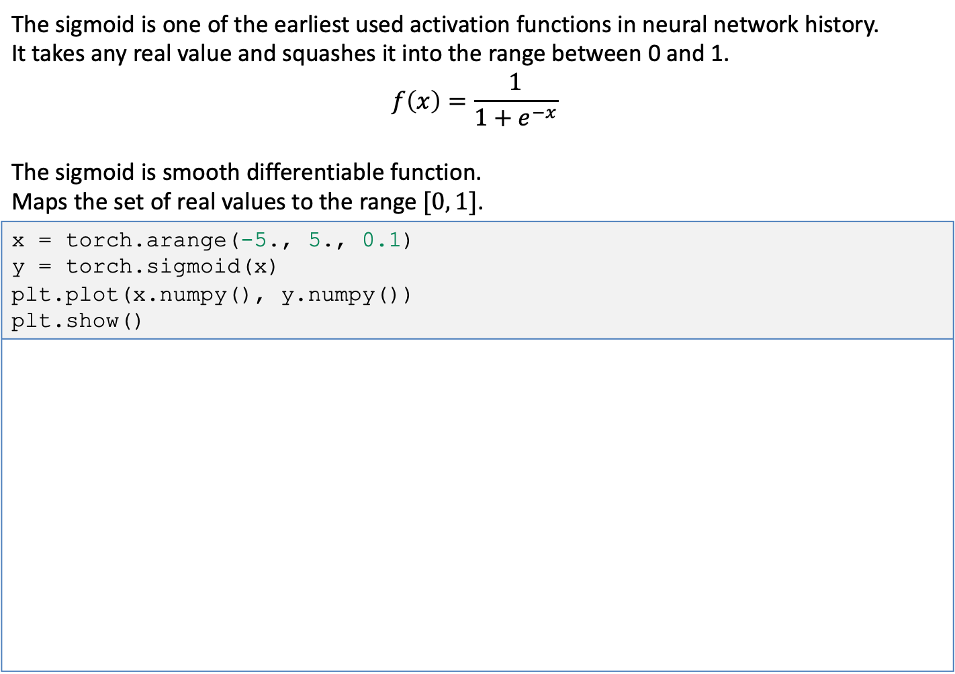
Activation functions - sigmoid
The sigmoid is one of the earliest used activation functions in neural network history. It takes any real value and squashes it into the range between 0 and 1. $$f\left(x\right)=\frac{1}{1+e^{−x}}$$ The sigmoid is smooth differentiable function. Maps the set of real values to the range $[0, 1]$.
x = torch.arange(-5., 5., 0.1) y = torch.sigmoid(x) plt.plot(x.numpy(), y.numpy()) plt.show()

Slide 7
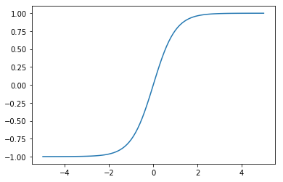
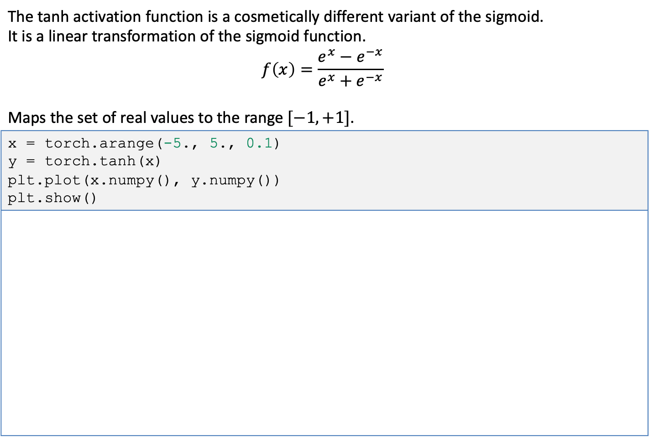
Activation functions - tanh
The tanh activation function is a cosmetically different variant of the sigmoid. It is a linear transformation of the sigmoid function. $$f\left(x\right)=\frac{e^{x}−e^{−x}}{e^{x}+e^{−x}}$$ Maps the set of real values to the range $[−1, +1]$.
x = torch.arange(-5., 5., 0.1) y = torch.tanh(x) plt.plot(x.numpy(), y.numpy()) plt.show()

Slide 8
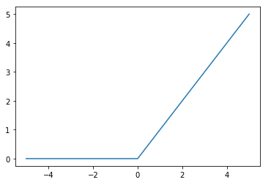
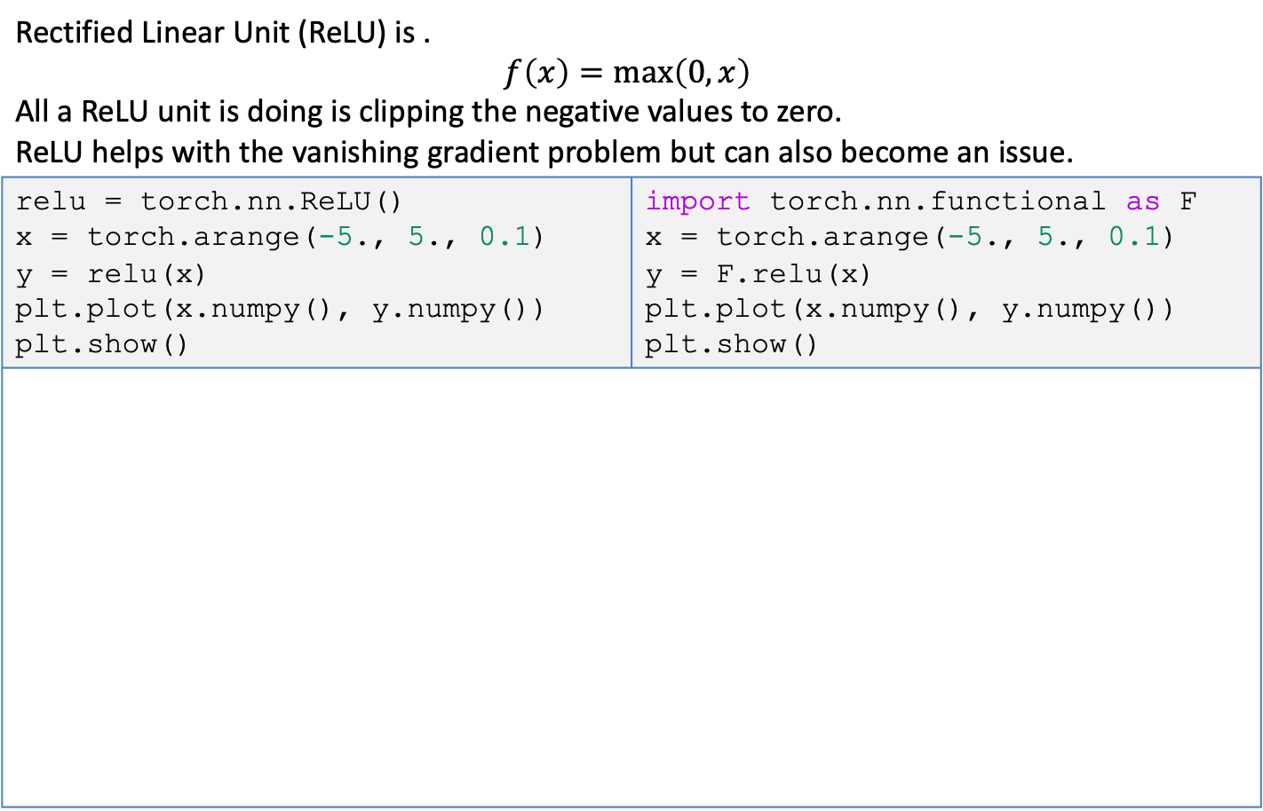
Activation functions - ReLU
Rectified Linear Unit (ReLU) is . $$f\left(x\right)=\max\left(0, x\right)$$ All a ReLU unit is doing is clipping the negative values to zero. ReLU helps with the vanishing gradient problem but can also become an issue.
relu = torch.nn.ReLU() x = torch.arange(-5., 5., 0.1) y = relu(x) plt.plot(x.numpy(), y.numpy()) plt.show() | import torch.nn.functional as F x = torch.arange(-5., 5., 0.1) y = F.relu(x) plt.plot(x.numpy(), y.numpy()) plt.show()

Slide 9
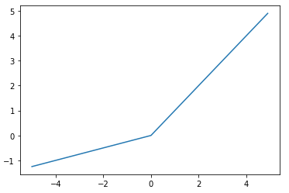
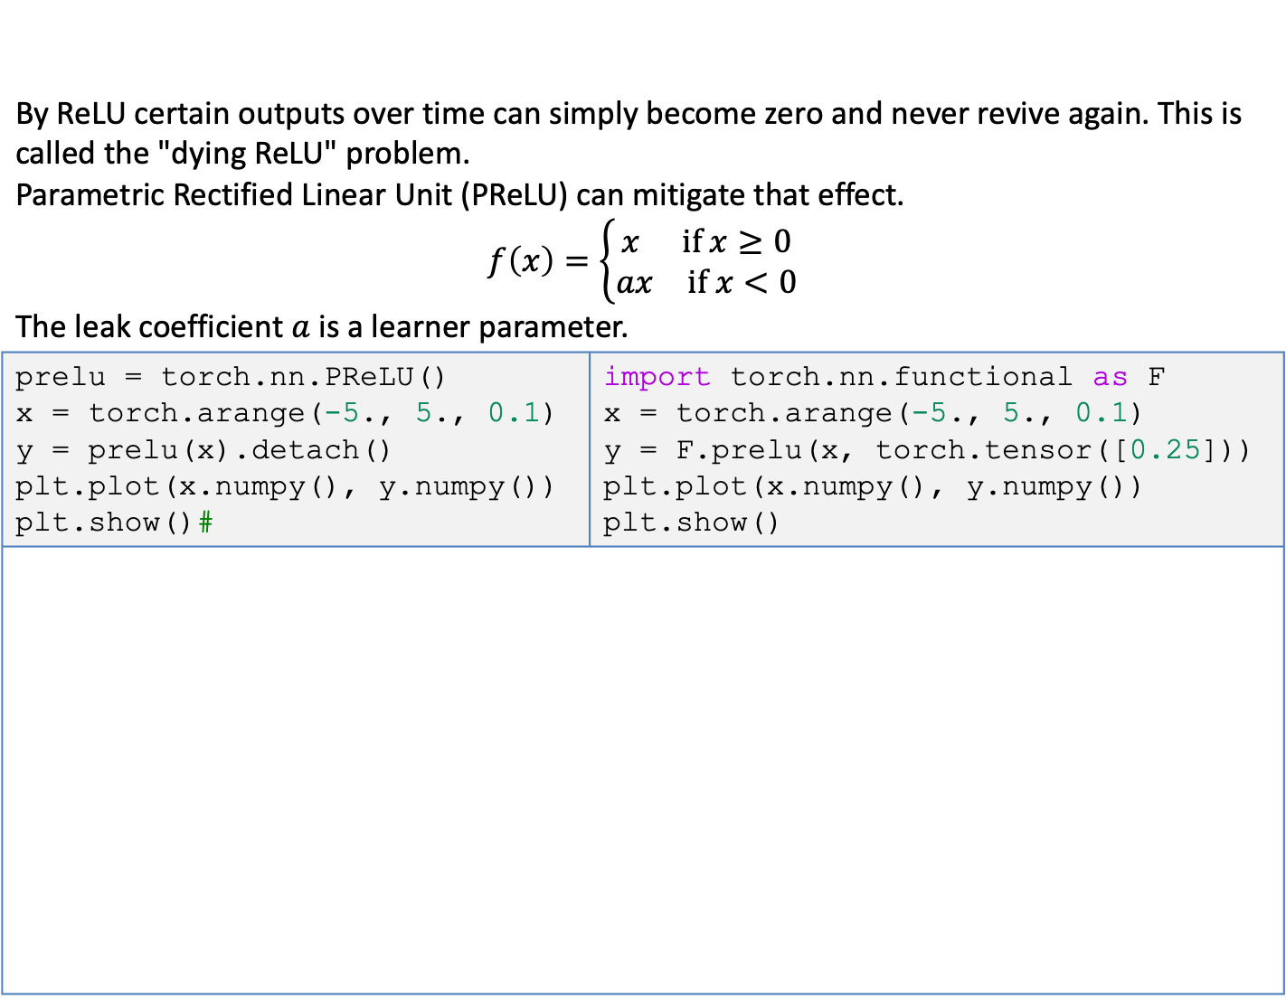
Activation functions - PReLU
By ReLU certain outputs over time can simply become zero and never revive again. This is called the "dying ReLU" problem. Parametric Rectified Linear Unit (PReLU) can mitigate that effect. $$f\left(x\right)=\left\{\begin{aligned}\begin{matrix}x & \text{if} x≥0\end{matrix} \\ \begin{matrix}ax & \text{if} x<0\end{matrix}\end{aligned}\right.$$ The leak coefficient $a$ is a learner parameter.
prelu = torch.nn.PReLU() x = torch.arange(-5., 5., 0.1) y = prelu(x).detach() plt.plot(x.numpy(), y.numpy()) plt.show()# | import torch.nn.functional as F x = torch.arange(-5., 5., 0.1) y = F.prelu(x, torch.tensor([0.25])) plt.plot(x.numpy(), y.numpy()) plt.show()

Slide 10
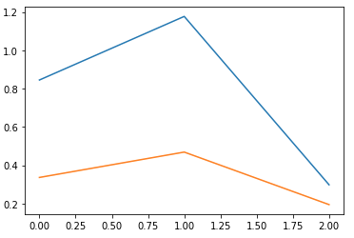
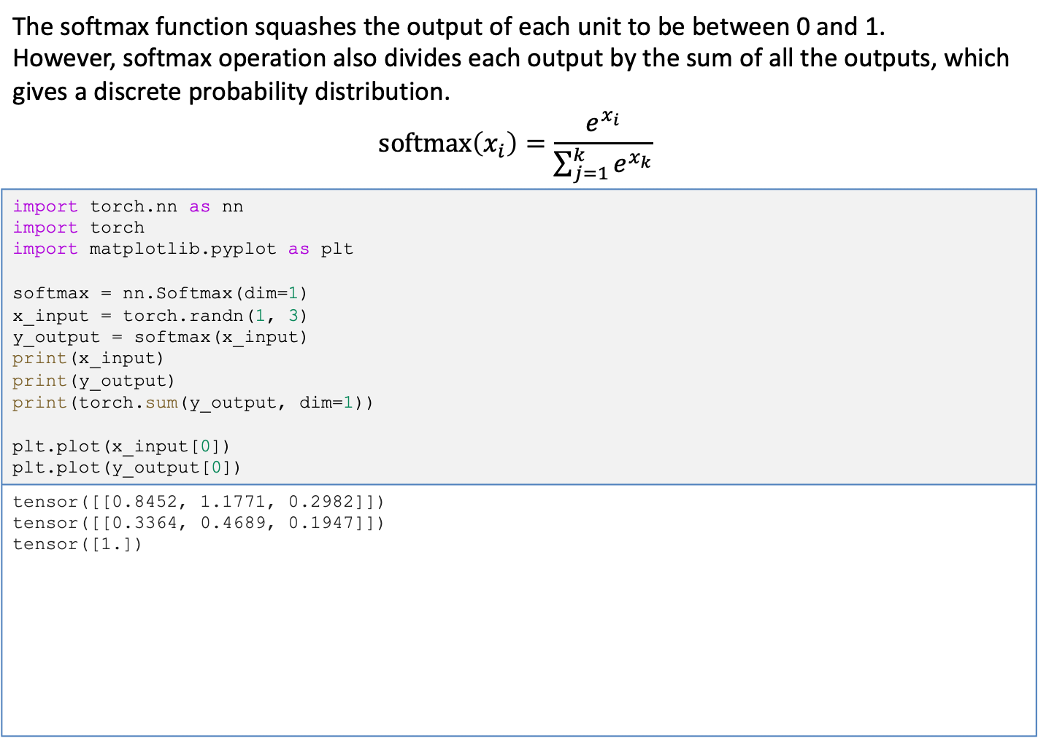
Activation functions - softmax
The softmax function squashes the output of each unit to be between 0 and 1. However, softmax operation also divides each output by the sum of all the outputs, which gives a discrete probability distribution. $$\text{softmax}\left(x_{i}\right)=\frac{e^{x_{i}}}{\sum_{j=1}^{k}{e^{x_{k}}}}$$
import torch.nn as nn import torch import matplotlib.pyplot as plt softmax = nn.Softmax(dim=1) x_input = torch.randn(1, 3) y_output = softmax(x_input) print(x_input) print(y_output) print(torch.sum(y_output, dim=1)) plt.plot(x_input[0]) plt.plot(y_output[0])
tensor([[0.8452, 1.1771, 0.2982]]) tensor([[0.3364, 0.4689, 0.1947]]) tensor([1.])

Slide 11

Loss functions
Loss function takes a truth ($y$) and a prediction ($\hat{y}$) as an input and produces a real-valued score.
The lower this score, the better the model's prediction is.
mean squared error
categorical cross entropy
binary cross entropy

Slide 12
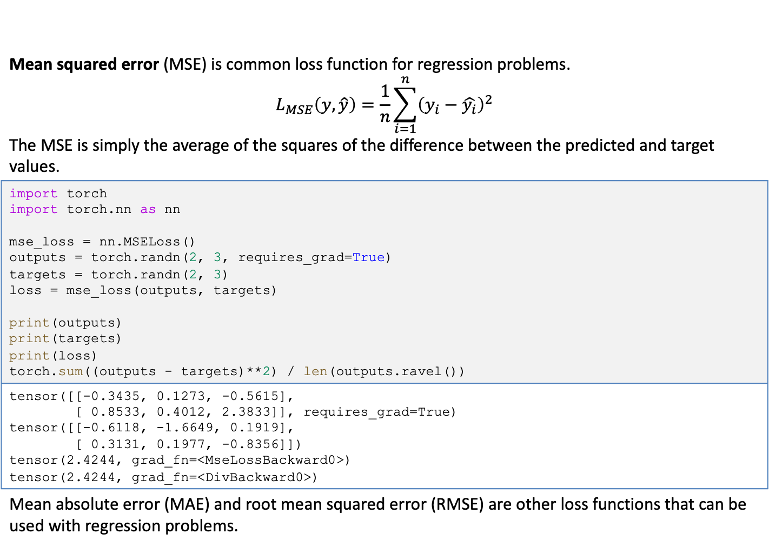
Loss functions - Mean Squared Error
Mean squared error (MSE) is common loss function for regression problems. $$L_{MSE}\left(y,\hat{y}\right)=\frac{1}{n}\sum_{i=1}^{n}{{\left(y_{i}−\hat{y_{i}}\right)}^{2}}$$ The MSE is simply the average of the squares of the difference between the predicted and target values.
import torch import torch.nn as nn mse_loss = nn.MSELoss() outputs = torch.randn(2, 3, requires_grad=True) targets = torch.randn(2, 3) loss = mse_loss(outputs, targets) print(outputs) print(targets) print(loss) torch.sum((outputs - targets)**2) / len(outputs.ravel())
tensor([[-0.3435, 0.1273, -0.5615], [ 0.8533, 0.4012, 2.3833]], requires_grad=True) tensor([[-0.6118, -1.6649, 0.1919], [ 0.3131, 0.1977, -0.8356]]) tensor(2.4244, grad_fn=<MseLossBackward0>) tensor(2.4244, grad_fn=<DivBackward0>)
Mean absolute error (MAE) and root mean squared error (RMSE) are other loss functions that can be used with regression problems.

Slide 13
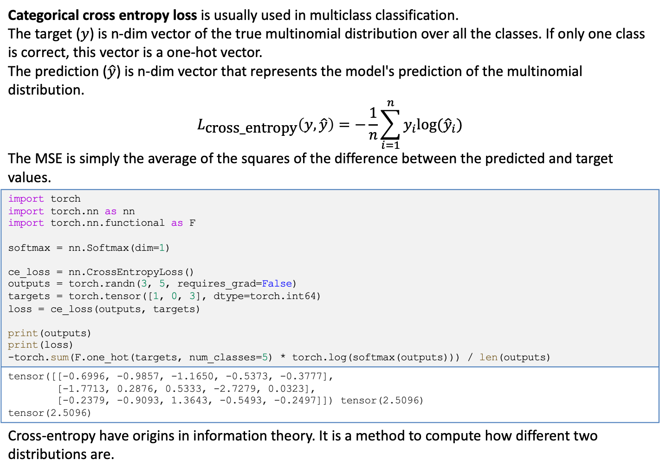
Loss functions – Categorical Cross Entropy Loss
Categorical cross entropy loss is usually used in multiclass classification. The target ($y$) is n-dim vector of the true multinomial distribution over all the classes. If only one class is correct, this vector is a one-hot vector. The prediction ($\hat{y}$) is n-dim vector that represents the model's prediction of the multinomial distribution. $$L_{\text{cross}\text{_}\text{entropy}}\left(y,\hat{y}\right)=−\frac{1}{n}\sum_{i=1}^{n}{y_{i}log⁡({\hat{y}}_{i})}$$ The MSE is simply the average of the squares of the difference between the predicted and target values.
import torch import torch.nn as nn import torch.nn.functional as F softmax = nn.Softmax(dim=1) ce_loss = nn.CrossEntropyLoss() outputs = torch.randn(3, 5, requires_grad=False) targets = torch.tensor([1, 0, 3], dtype=torch.int64) loss = ce_loss(outputs, targets) print(outputs) print(loss) -torch.sum(F.one_hot(targets, num_classes=5) * torch.log(softmax(outputs))) / len(outputs)
tensor([[-0.6996, -0.9857, -1.1650, -0.5373, -0.3777], [-1.7713, 0.2876, 0.5333, -2.7279, 0.0323], [-0.2379, -0.9093, 1.3643, -0.5493, -0.2497]]) tensor(2.5096) tensor(2.5096)
Cross-entropy have origins in information theory. It is a method to compute how different two distributions are.

Slide 14
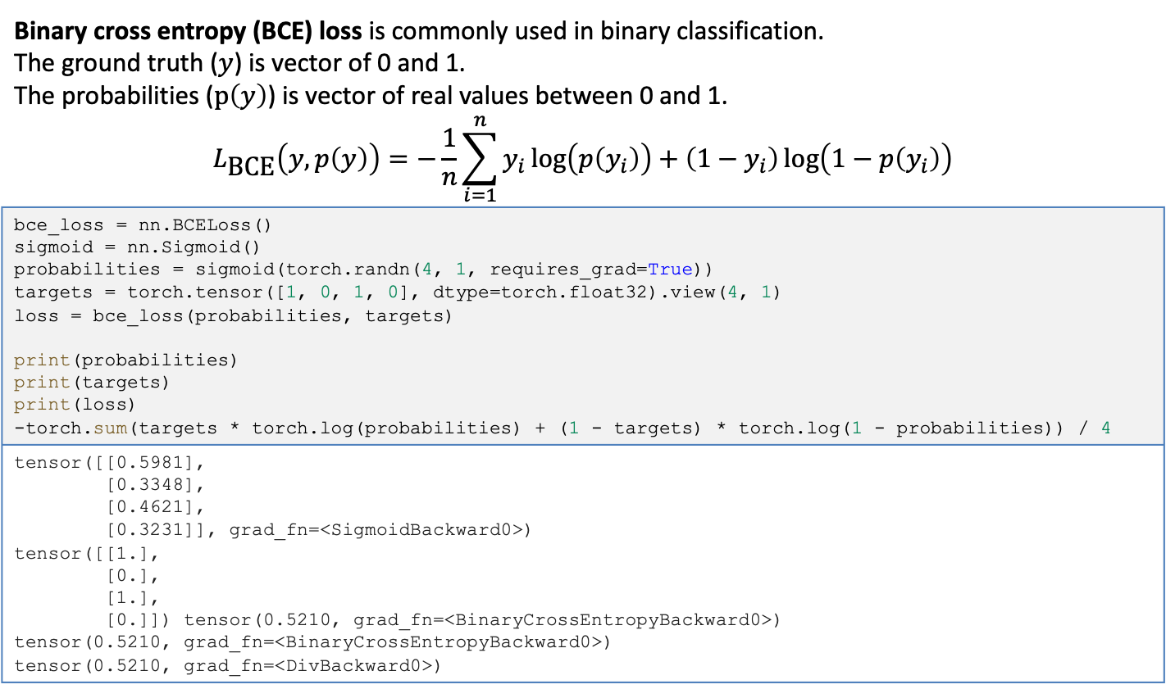
Loss functions – Binary Cross Entropy Loss
Binary cross entropy (BCE) loss is commonly used in binary classification. The ground truth ($y$) is vector of 0 and 1. The probabilities ($p\left(y\right)$) is vector of real values between 0 and 1. $$L_{\text{BCE}}\left(y,p\left(y\right)\right)=−\frac{1}{n}\sum_{i=1}^{n}{y_{i}\log\left(p\left(y_{i}\right)\right)+\left(1−y_{i}\right)\log\left(1−p\left(y_{i}\right)\right)}$$
bce_loss = nn.BCELoss() sigmoid = nn.Sigmoid() probabilities = sigmoid(torch.randn(4, 1, requires_grad=True)) targets = torch.tensor([1, 0, 1, 0], dtype=torch.float32).view(4, 1) loss = bce_loss(probabilities, targets) print(probabilities) print(targets) print(loss) -torch.sum(targets * torch.log(probabilities) + (1 - targets) * torch.log(1 - probabilities)) / 4
tensor([[0.5981], [0.3348], [0.4621], [0.3231]], grad_fn=<SigmoidBackward0>) tensor([[1.], [0.], [1.], [0.]]) tensor(0.5210, grad_fn=<BinaryCrossEntropyBackward0>) tensor(0.5210, grad_fn=<BinaryCrossEntropyBackward0>) tensor(0.5210, grad_fn=<DivBackward0>)

Slide 15
Supervised Training
Supervised learning is the problem of learning how to map observations to specified targets given labeled examples.
How to use model predictions and a loss function to do gradient-based optimization of a model's parameters.

